Slide 1
Course : Advanced ASP.NET and WCF
Session : Web Services
Notes:
1

Slide 2
Web Service definition
A simple definition:
“a Web Service is an application component accessible over open protocols”.

Slide 3
History
Web services evolved from previous technologies that served the same purpose such as RPC, ORPC (DCOM, CORBA and JAVA RMI).
Web Services were intended to solve three main problems:
Interoperability
Firewall traversal
Complexity

Slide 4
Interoperability
Earlier distributed systems suffered from interoperability issues because each vendor implemented its own on-wire format for distributed object messaging.
Development of DCOM apps strictly bound to Windows Operating system.
Development of RMI bound to Java programming language.

Slide 5
Firewall traversal
Collaboration across corporations was an issue because distributed systems such as CORBA and DCOM used non-standard ports.
Web Services use HTTP as a transport protocol and most of the firewalls allow access though port 80 (HTTP), leading to easier and dynamic collaboration.

Slide 6
Complexity
Web Services is a developer-friendly service system.
Most of the above-mentioned technologies such as RMI, COM, and CORBA involve a whole learning curve.
New technologies and languages have to be learnt to implement these services.

Slide 7
Web Service definition revisited
A more precise definition:
an application component that:
Communicates via open protocols (HTTP, SMTP, etc.)
Processes XML messages framed using SOAP
Describes its messages using XML Schema
Provides an endpoint description using WSDL
Can be discovered using UDDI

Slide 8
Web Services Components
XML – eXtensible Markup Language – A uniform data representation and exchange mechanism.
SOAP – Simple Object Access Protocol – A standard way for communication.
UDDI – Universal Description, Discovery and Integration specification – A mechanism to register and locate WS based application.
WSDL – Web Services Description Language – A standard meta language to described the services offered.

Slide 9
The Web Service Model
The Web Services architecture is based upon the interactions between three roles:
Service provider
Service registry
Service requestor
The interactions involve the:
Publish operations
Find operation
Bind operations.

Slide 10
The Web Service Model (cont)
The Web Services model follows the publish, find, and bind paradigm.
1. publish 2. find
3. bind/invoke
Web Service
Registry
Web Service
Provider
Web Service
Client

Slide 11
XML
XML stands for EXtensible Markup Language.
XML is a markup language much like HTML.
XML was designed to describe data.
XML tags are not predefined. You must define your own tags.
The prefect choice for enabling cross-platform data communication in Web Services.

Slide 12
XML vs HTML
This will be displayed as:
John Doe 2 Backroads Lane New York 045935435 John.doe@gmail.com
HTML specifies how the document is to be displayed, and not what information is contained in the document.
Hard for machine to extract the embedded information. Relatively easy for human.

Slide 13
XML vs HTML
Now look at the following:
<?xml version=1.0?> <contact> <name>John Doe</name> <address>2 Backroads Lane</address> <country>New York</country> <phone>045935435</phone> <email>john.doe@gmail.com</email> </contact>
In this case:
The information contained is being marked, but not for displaying.
Readable by both human and machines.

Slide 14
Step By Step – Creating a Web Service
In this Step I will create a new Web Service and write a Simple Program that uses it.
The program will perform various operations on an array.
The client program will be a simple dialog box that activates those operations.

Slide 15
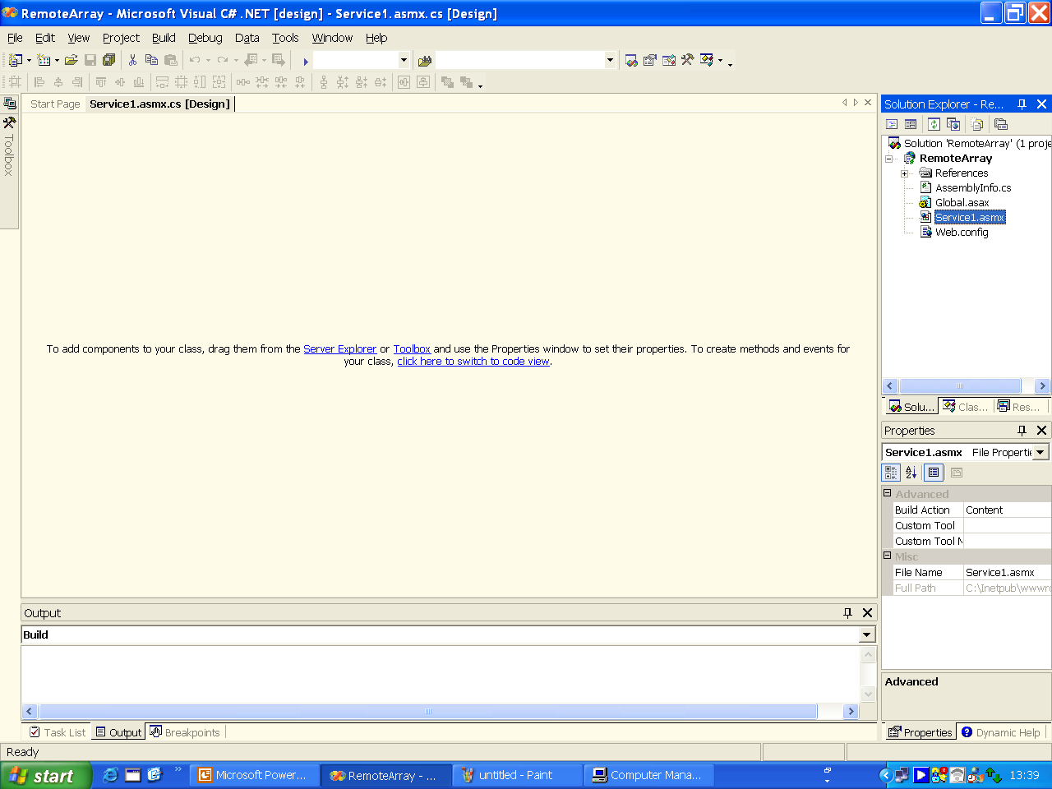
Step By Step – Creating a Web Service
Create a new Visual C# project with the name RemoteArray. The following screen appears.

Slide 16
Step By Step – Creating a Web Service
To see the code Press on the following hyperlink.

Slide 17
Step By Step – Creating a Web Service
Right Click on the References folder and choose add Reference.
Insert the System.Windows.Forms.dll option in to this folder.

Slide 18
Step By Step – Creating a Web Service

Slide 19
Step By Step – Creating a Web Service

Slide 20
Step By Step – Creating a Web Service
Insert the following code to the .asmx file you’ve created.

Slide 21
Step By Step – Creating a Web Service

Slide 22
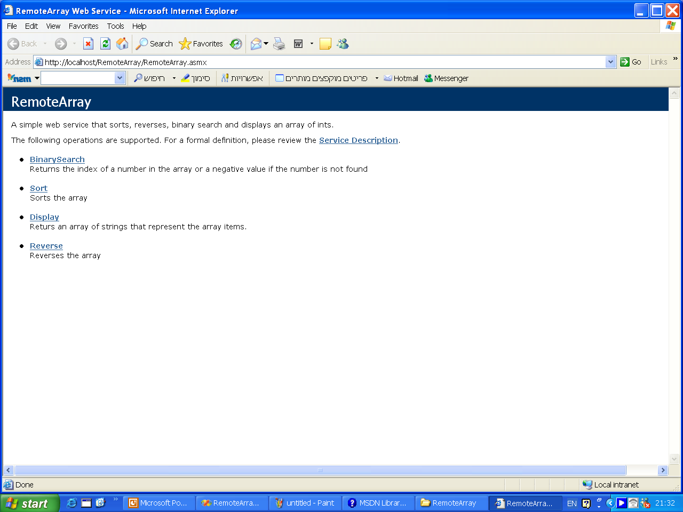
Step By Step – Creating a Web Service
Press Ctrl +F5 to Run the Web service.

